Slide 1
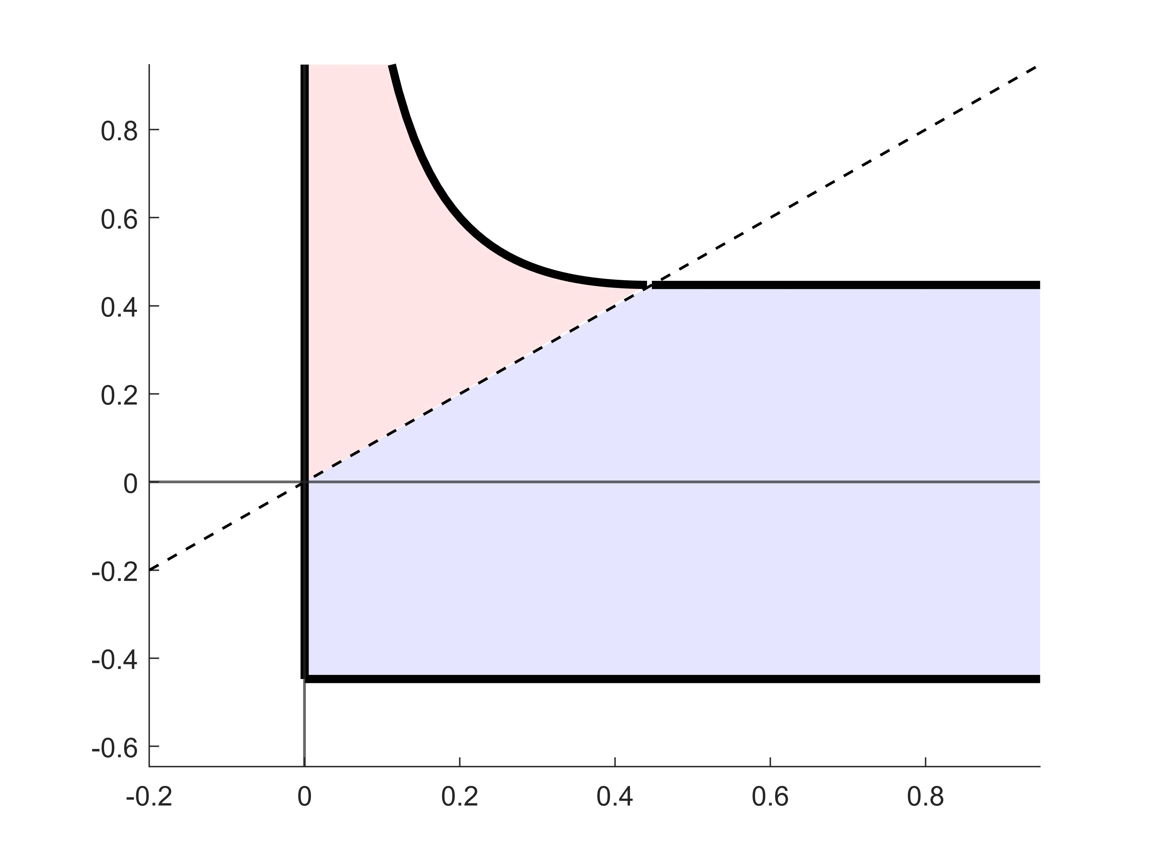









$$η=λ$$
$$λη−\frac{1}{2}λ^{2}=s$$
$$ℛ_{2}$$
$$η=\sqrt{2s}$$
$$η$$
$$ℛ_{1}$$
$$λ=0$$
$$η=−\sqrt{2s}$$
$$λ$$

Slide 2
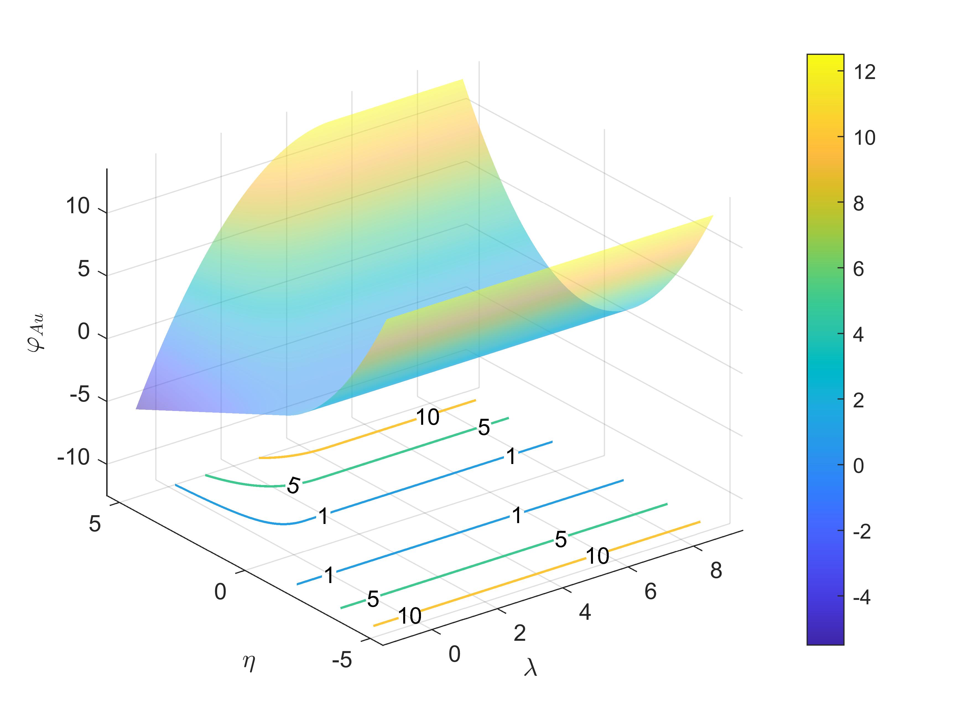

Slide 3
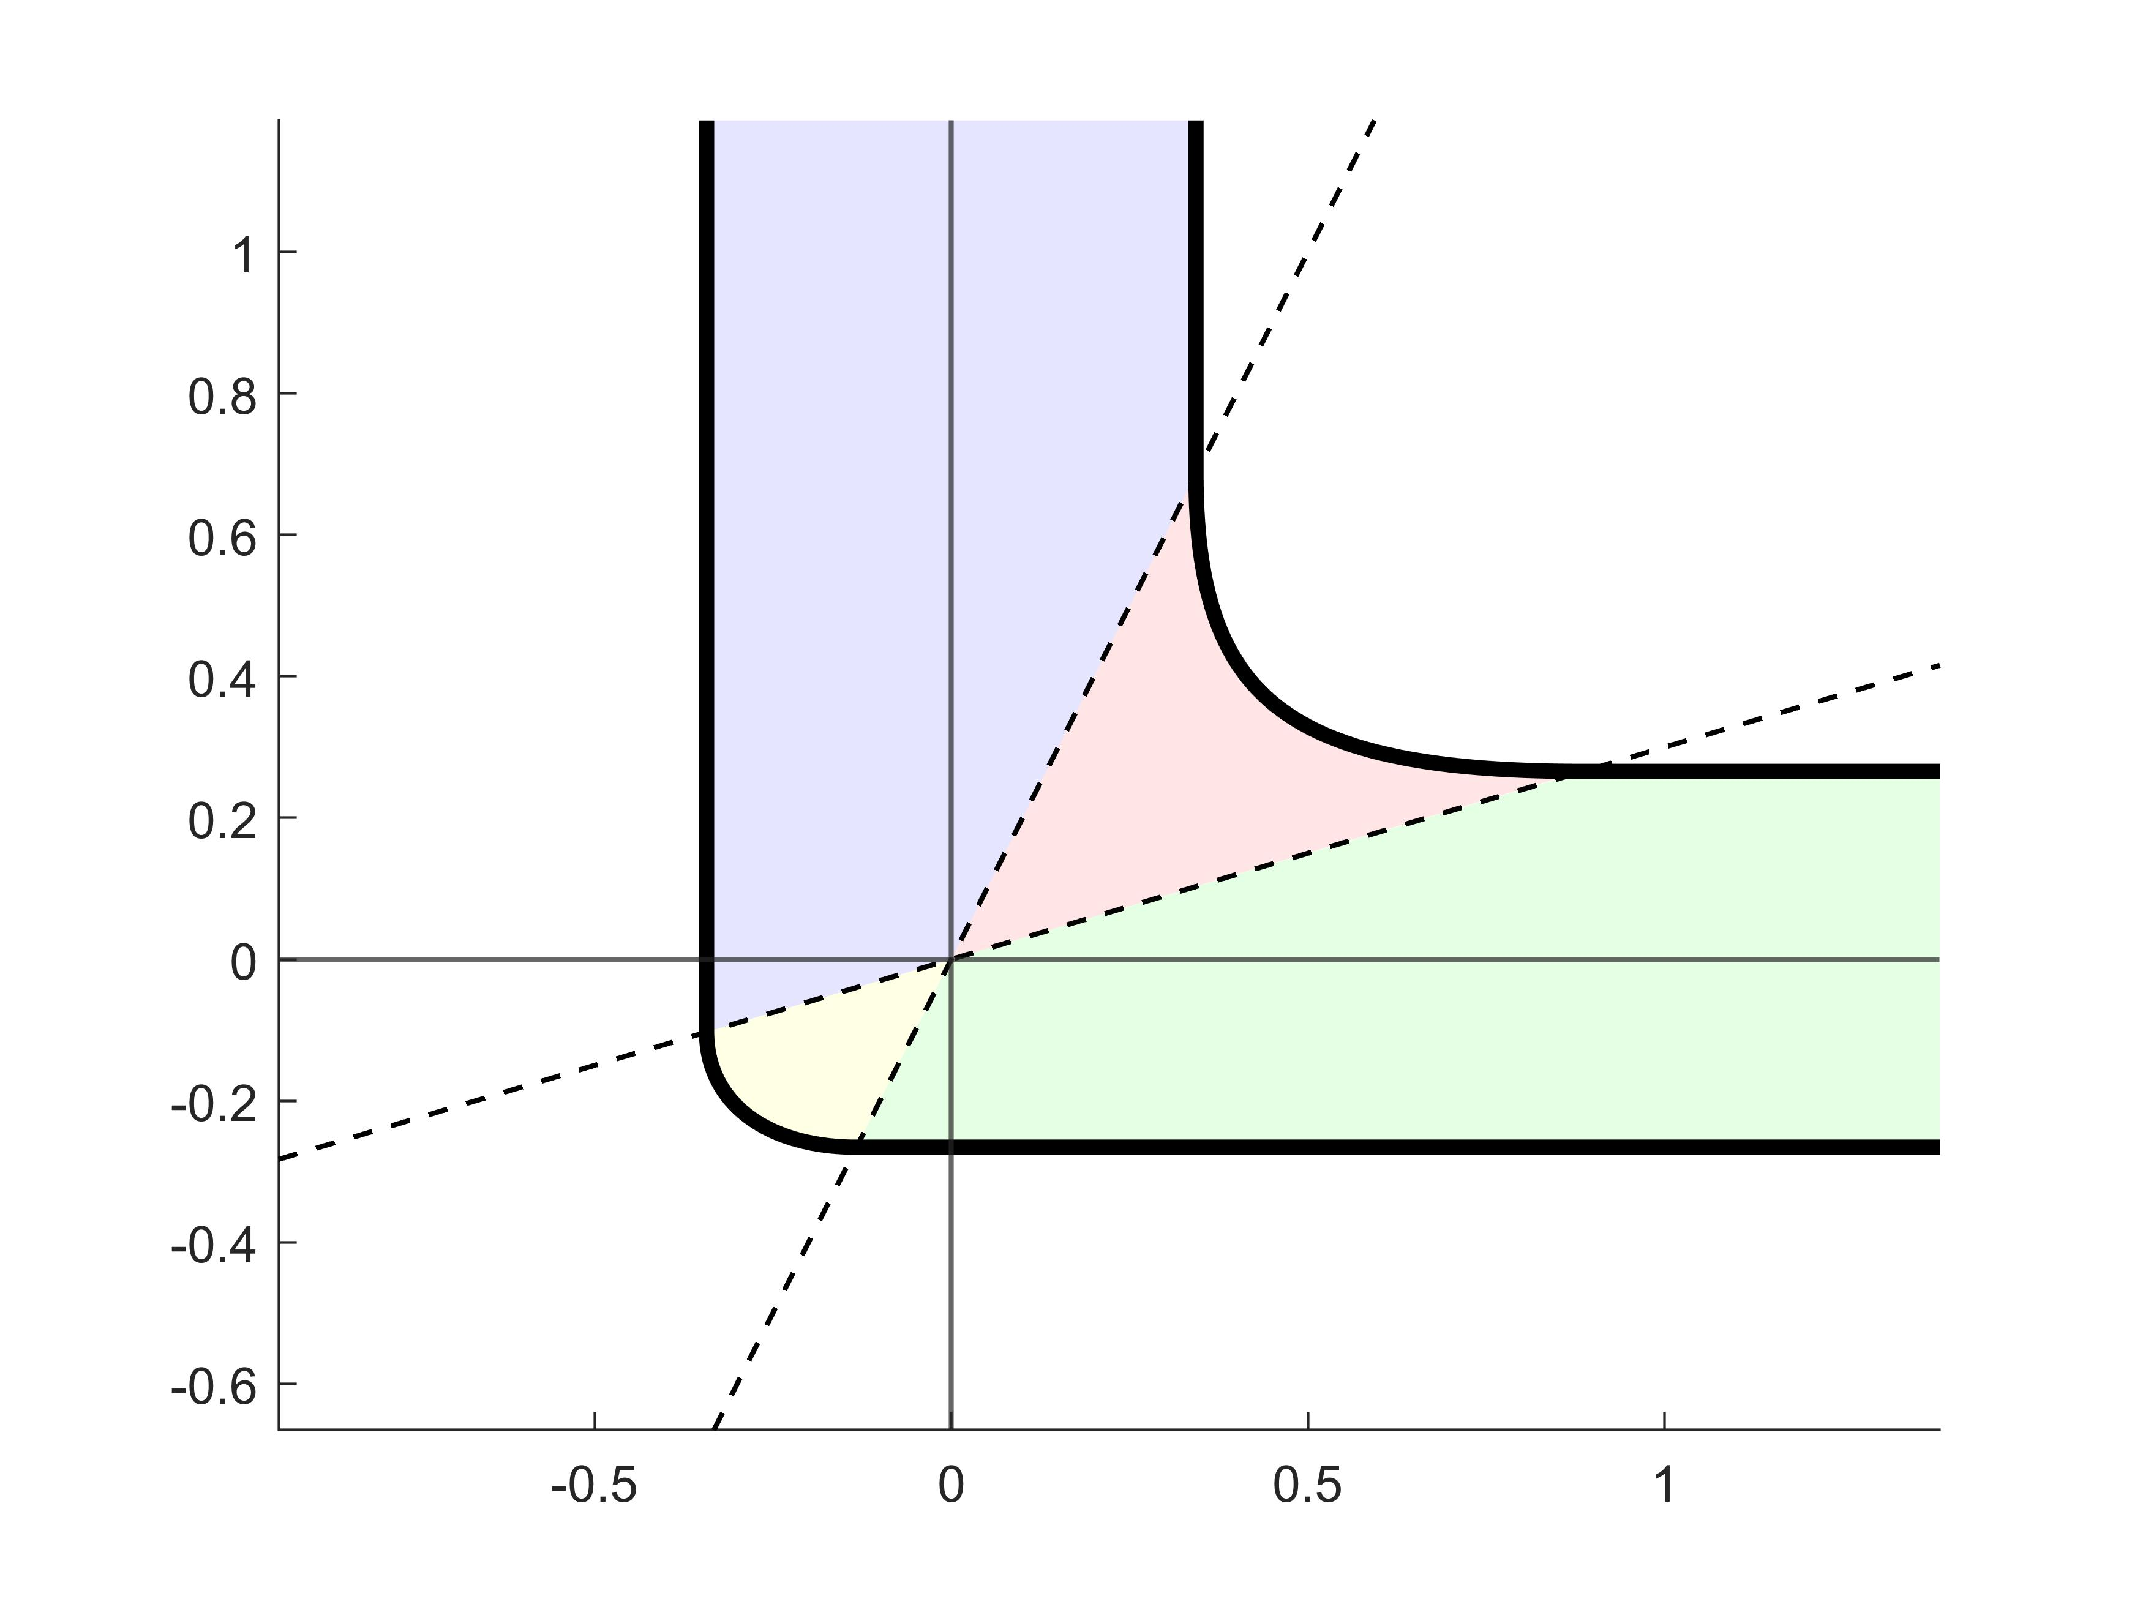










$$η=bλ$$
$$\left|λ\right|=\sqrt{\frac{2s}{b−a}}$$
$$−\frac{a}{2}λ^{2}+λη−\frac{1}{2b}η^{2}=s$$
$$η=aλ$$
$$ℛ_{1}^{ab}$$
$$η$$
$$ℛ_{2}^{ab}$$
$$\left|η\right|=\sqrt{\frac{2abs}{b−a}}$$
$$ℛ_{4}^{ab}$$
$$ℛ_{3}^{ab}$$
$$\frac{b}{2}λ^{2}−λη+\frac{1}{2a}η^{2}=s$$
$$λ$$

Slide 4
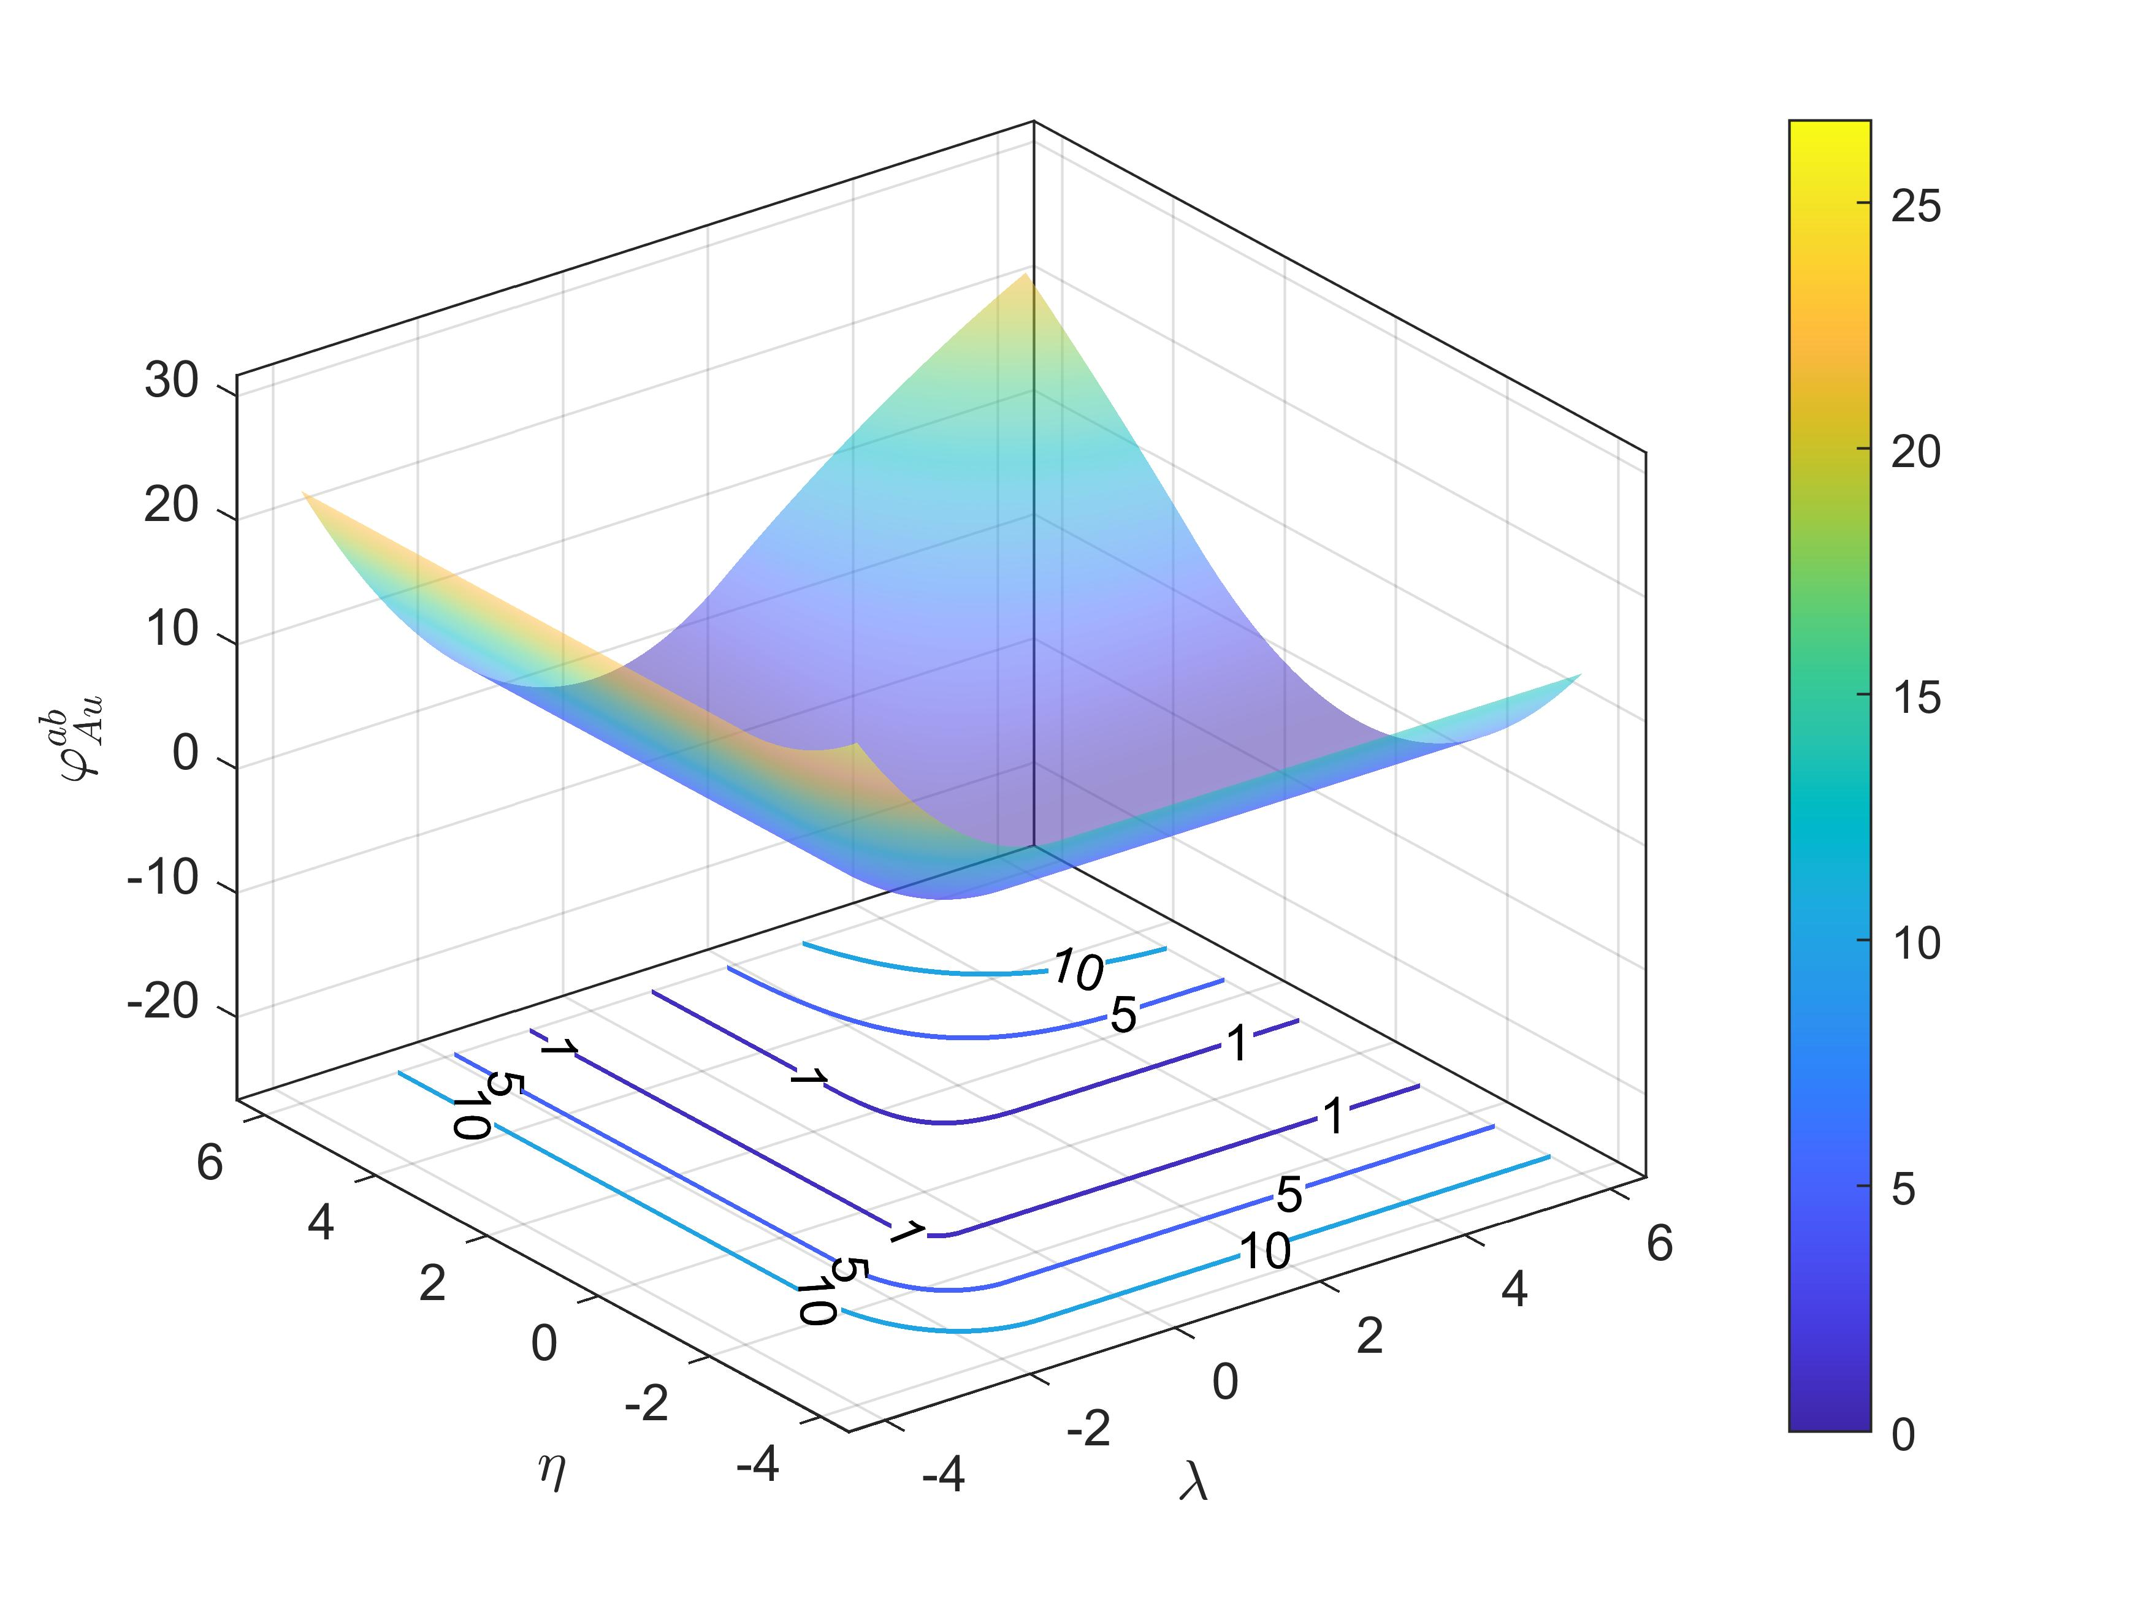

Slide 5
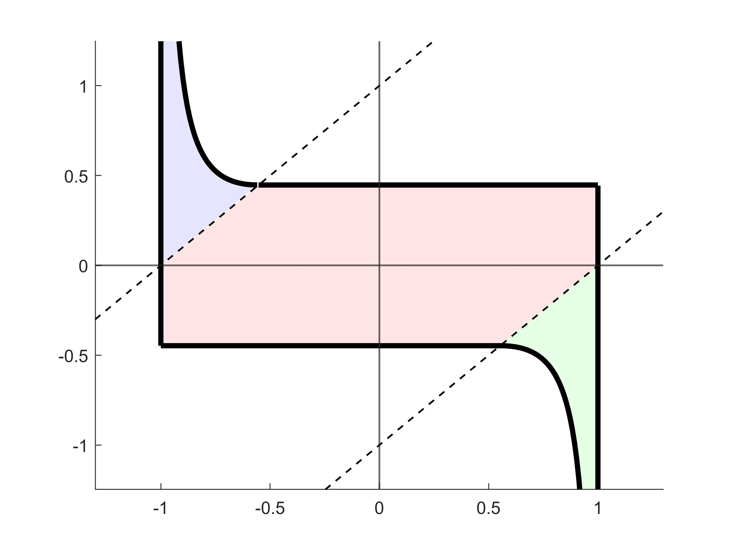












$$η\left(λ−b_{l}\right)−\frac{1}{2}{\left(λ−b_{l}\right)}^{2}=s$$
$$η=λ−b_{l}$$
$$η=λ−b_{u}$$
$$ℛ_{1}$$
$$η=\sqrt{2s}$$
$$η$$
$$ℛ_{2}$$
$$η=−\sqrt{2s}$$
$$λ=b_{l}$$
$$λ=b_{u}$$
$$ℛ_{3}$$
$$η\left(λ−b_{u}\right)−\frac{1}{2}{\left(λ−b_{u}\right)}^{2}=s$$
$$λ$$

Slide 6
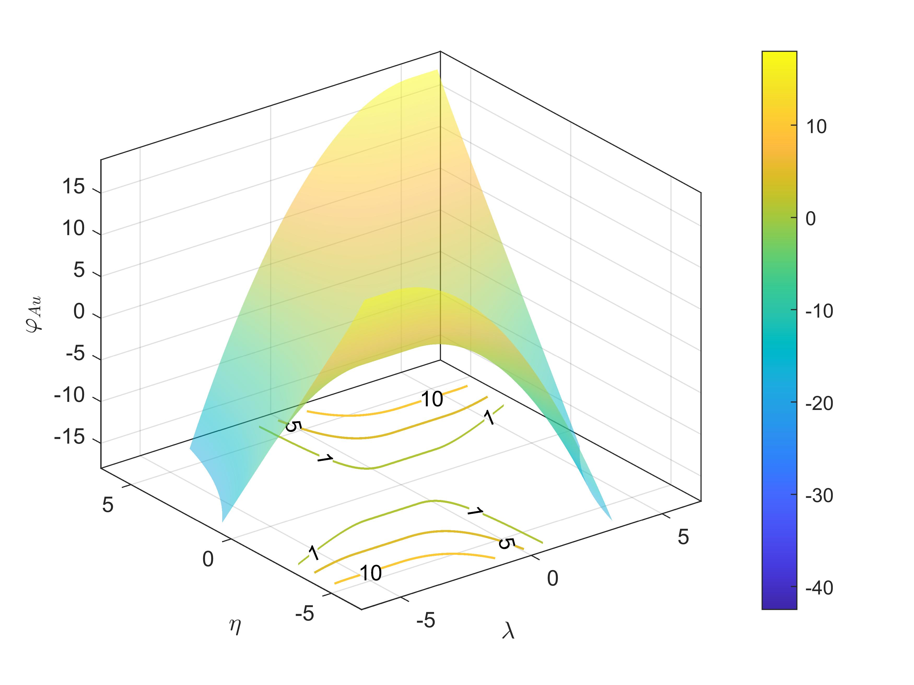

Slide 7
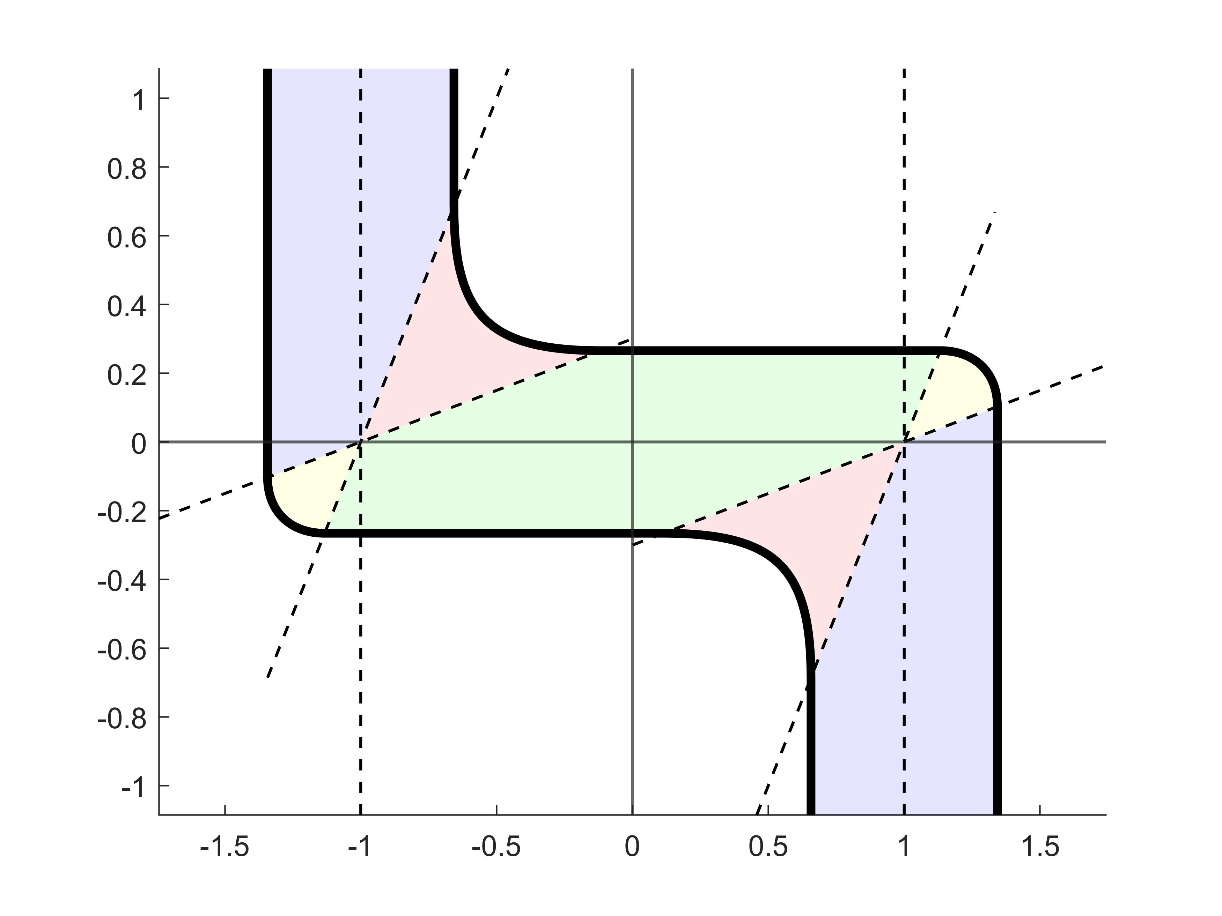




















$$η=q_{1}\left(λ\right)$$
$$λ=b_{u}$$
$$\left|λ−b_{l}\right|=\sqrt{\frac{2s}{b−a}}$$
$$η=q_{2}\left(λ\right)$$
$$f_{1}\left(λ,η\right)=s$$
$$f_{4}\left(λ,η\right)=s$$
$$ℛ_{1}^{ab}$$
$$ℛ_{2}^{ab}$$
$$\left|η\right|=\sqrt{\frac{2abs}{b−a}}$$
$$ℛ_{6}^{ab}$$
$$η$$
$$η=q_{4}\left(λ\right)$$
$$ℛ_{3}^{ab}$$
$$ℛ_{4}^{ab}$$
$$ℛ_{5}^{ab}$$
$$ℛ_{7}^{ab}$$
$$f_{2}\left(λ,η\right)=s$$
$$f_{3}\left(λ,η\right)=s$$
$$\left|λ−b_{u}\right|=\sqrt{\frac{2s}{b−a}}$$
$$η=q_{3}\left(λ\right)$$
$$λ=b_{l}$$
$$λ$$

Slide 8
